Slide 1
Advances in non-invasive inspections
A review on methods and tools
By
Mubarak M. Alotaibi
(PhD Student)
Cranfield University
Dr Muhammad A. Khan
Cranfield University
Senior Lecturer in Fatigue and Damage Tolerance

Slide 2
The paper’s outlines
Introduction to maintenance methods
Introduction to non-invasive inspection NII
The needs for NII
Definition of NII
Tools use to demonstrate NII
Analysis of the literature review
Evaluation for conventional tools
Identifying the research gaps
passible research contributions
Conclusions

Slide 3
Introduction
Evolution of maintenance strategy
Reviewing published articles
Identifying advantages and limitations of earlier maintenance practised.
Research for a technique that works without any intrusive instrumentation requirement (Non-Invasive Inspection NII)
Evaluation of radar sensing technique

Slide 4
Maintenance types 1/2
Breakdown advantages such as
No requirement of prior resource planning and schedules
Very simple process
Low workforce require
Breakdown limitation such as
Catastrophic damage of the assets
Costly repair and replacement
Long stoppages and delays in operations
Preventive maintenance advantage
Machine run for longer time
Safety enhanced
Preventive maintenance limitation
Still sudden failures and unnecessary repairs were observed
Overcome the costly repairs due to the remaining useful life RUL
(Before you continue to YouTube, 2021)

Slide 5
Maintenance types 2/2
Predictive and Condition monitoring-based Maintenance advantage
Cost and time of machine out of a process is reduced
Failure reduced and performance enhanced
Safety increased
Predictive maintenance disadvantage.
Requires a suitable number of sensors and instrumentations
Required intrusive installation on the assets
Research for a technique that works without any intrusive instrumentation

Slide 6
Non-Invasive Inspection Technique
Needs & features and definition.
Non-Invasive inspection becomes a fundamental tool in modern industrial maintenance
It has remote and online inspection and monitoring features
Operators are fully aware of the machine’s health.
Saves money, lives, production and the environment
NII definition
There was no formal definition about NII in the existing literature.
Non-destructive technique and tools categorized into two distinct categories

Slide 7
Definition of NI Inspections
A) Définition : Non-contact-base NI inspections (NCNI)
The sensing element does not require physical contact with a machine or with the machine system
B) Definition: Contact-based NI inspections (CNI)
The sensing element does not require physical contact with a machine ,but it is installed with the machine system

Slide 8
Tools and Methods of NI inspections
non-contact-based sensing
Contact-based sensors
Flux radiation, Voltage and Current sensing
Vibration-based Technique
Wear Debris
Radiofrequency
Radar
Ultrasonic Sensing
Camera based imaging
Acoustic Emission sensing
Thermographic sensing
laser

Slide 9
limitation
Contact-based Techniques
Non-contact-based technique
(Kia, Henao and Capolino, 2012) compared different techniques, but the current analysis could not detect bearing faults.
(Pusca et al., 2012) used flux analysis, but it shows limitation to detect a fault during load change.
(Allison and Crabtree, 2015) used coil configuration and sensing method to detect wear debris particles but could not detect small parts.
(Wang et al., 2020) & (Wotzka and Cichoń, 2020) and others used acoustic tech. to investigate faults but, the noise was available.
(Janssens et al., 2015) faced light impacts during the use of infrared image-based.
Zhou, Brunskill and Lewis, 2019. uses Ultrasound technique to inspect wheel-rail, but during high speed, the catch was not straightforward.

Slide 10
A comparison of three types of fault detection techniques to detect pinion tooth surface damages.
Vibration technique the bearing fault.
Acoustic pressure also detected the fault.
The Current Analysis Technique did not detect the bearing fault.
(Kia, Henao and Capolino, 2012).

Slide 11
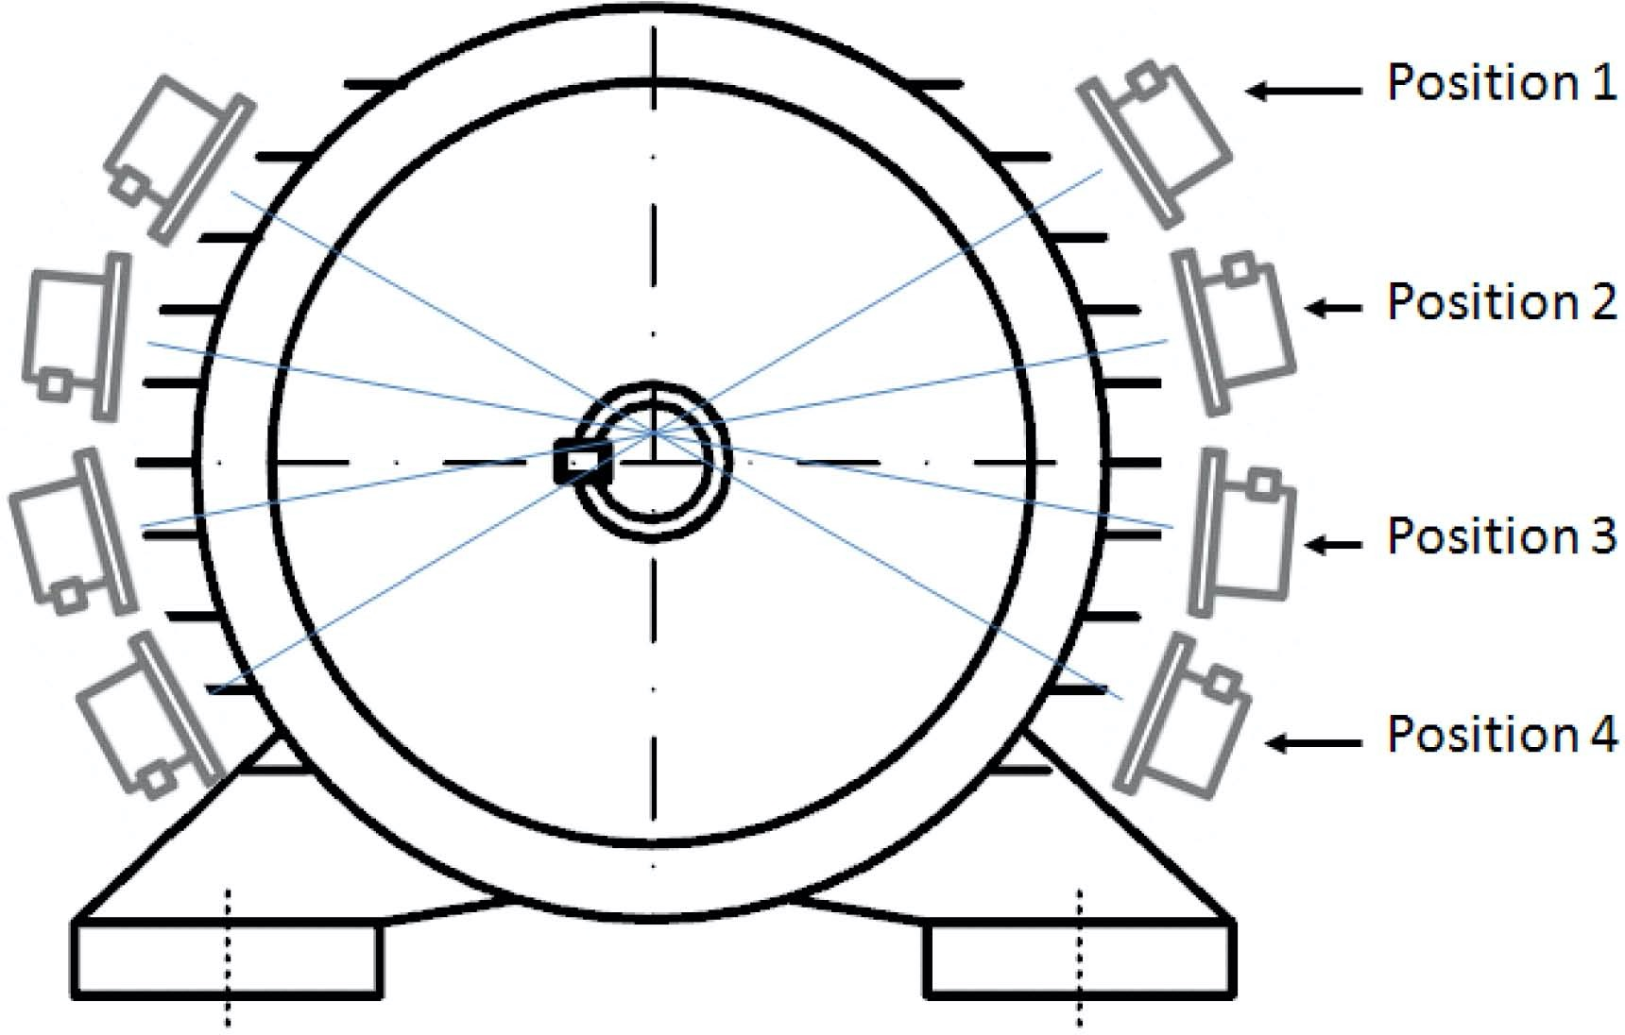
Analysis of the Literature Review. 1/3 Tools Evaluation: Contact-based sensor’s tools
Current, voltage and flux analysis techniques. The flux principle is based on measuring the motor's EMF radiation, which is influenced by a motor's loading and fault state.
Suitable only for an electrically driven machine but not with fuel machine engines
Power supply network influences the technique’s analysis.
Techniques also limited to evaluate machine faults during a change in operational loads
Methods faced difficulty in detecting and classifying the bearing faults
Flux analysis required a large number of sensors to get accurate results
Number of Flux sensors
(Pusca et al., 2012)

Slide 12
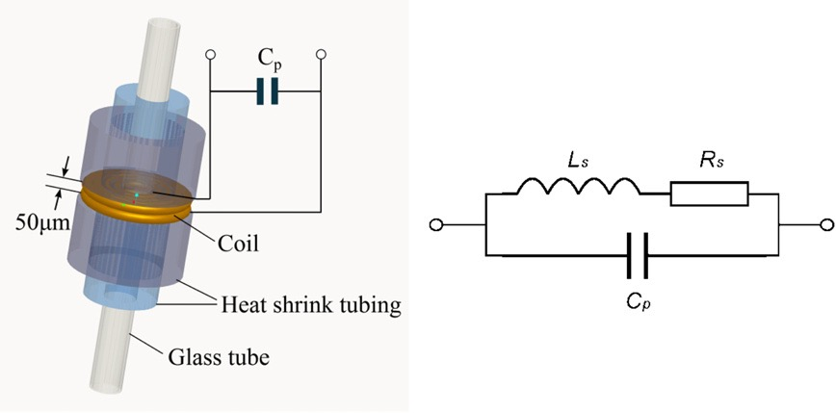
Analysis of the Literature Review. 2/3 Tools Evaluation: Contact-based sensor’s tools
II. Wear debris analysis
It is very accurate in finding out faults
difficult to classify the fault location
III. Vibration technique
Use as contact based on the machine's health and experimental
High accuracy in fault diagnosing
Vibration signals transmit through the entire body of the machine.
Oil debris detects by inductive pulse sensor
(Du et al., 2013)

Slide 13
Analysis of the Literature Review 3 Tools Evaluation: Non-contact-based sensing
Ultrasonic: Works based on sending high-frequency pulses signals frequently at the airspeed to strike objects which are called trig signals.
Very sensitive to temperature change
Resolution problems for very thin and small objects
Acoustic sensing technique: the principle is to detect machine noise and analyse that noise.
Impacts by the background noise.
Ultrasonic Principle (Panda, Agrawal, Nshimiyimana and Hossain, 2016)

Slide 14
Analysis of the Literature Review. 3 Tools Evaluation: Non-contact-based sensing
Thermographic sensing technique: Work based on measuring the surface temperature of objects.
Suitable to classify faults
Significantly affected by complex surface objects and lights
Measure short distance only.
Loss efficiency in long-distance
Better with the low data rate,
Gives better accuracy of measuring if the sensor and object at the same line of sight
(Jeffali et al., 2015)

Slide 15
Summery
Conventional methods disadvantages.
Radar features.
Conventional methods disadvantages.
Noise
Sensor location difficulty
Radar features.
Eliminate all disadvantage
Has not been used practically in machine health diagnosis
Different Limitations in conventional tools
Range of measure
Size of sensors
Detect multi machines simultaneously
Low cost
safe
RESEARCH GAP

Slide 16
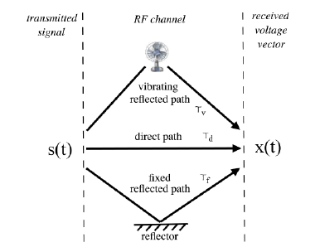
Radar sensing conventionally used
(Mueller and Pratt, 2013) used radar-based to inspect and monitor the vibration of a desktop fan in regular operation and simulated faulty condition.
(Roy et al., 2020) used Doppler-spectrum to detected two speakers supplied by 141 Hz and 113 Hz, the result 140.4Hz and 112.2 Hz with an accuracy of % 0.996 and % 0.993.
A research has done on 20 published paper non of them has used radar technique to detect machine health nor gearbox damages
(Mueller and Pratt, 2013)
(Roy et al., 2020)

Slide 17
Contribution
RST proposed to close the gaps due to the comprehensive features.
Creation of a new NII definition.
First time apply RST to measure machine health directly.
First time to apply RST to detect gear tooth damages.
First time to apply RST to detect machine shaft misalignment.

Slide 18
The research reviewed
The research has discussed maintenance types and show the advantage of the predictive and monitoring technique.
Investigated the possible definitions of the non-invasive inspection technique.
Create a new definition for NII contact and non-contact tools.
Highlight conventional techniques limitations.
Identified the features of the radar sensing technique and implemented.

Slide 19
References
Youtube.com. 2021. Before you continue to YouTube. [online] Available at: <https://www.youtube.com/watch?v=_tq91E9WRRY> [Accessed 4 June 2021].
Mueller, J. and Pratt, T., 2013. A Radio Frequency Polarimetric Sensor for Rotating Machine Analysis. IEEE Sensors Journal, 13(12), pp.4866-4873.
Roy, D., Sinharay, A., Bhowmick, B., Rakshit, R., Chakravarty, T. and Pal, A., 2020. A Novel RF-Assisted-Strobe System for Unobtrusive Vibration Detection of Machine Parts. IEEE Sensors Journal, 20(18), pp.10924-10935.
Kia, S. H., Henao, H. and Capolino, G. A. (2012) ‘A comparative study of acoustic, vibration and stator current signatures for gear tooth fault diagnosis’, in Proceedings - 2012 20th International Conference on Electrical Machines, ICEM 2012, pp. 1514–1519. doi: 10.1109/ICElMach.2012.6350079.
Pusca, R. et al. (2010) ‘An online universal diagnosis procedure using two external flux sensors applied to the AC electrical rotating machines’, Sensors (Switzerland), 10(11), pp. 10448–10466. doi: 10.3390/s101110448.
Allison, C. M. and Crabtree, C. J. (2015) ‘Development of inductive oil debris sensors for wind turbine gearboxes’, European Wind Energy Association Annual Conference and Exhibition 2015, EWEA 2015 - Scientific Proceedings, pp. 1–5.
Wang, R. et al. (2020) ‘A Non-Contact Fault Diagnosis Method for Rolling Bearings Based on Acoustic Imaging and Convolutional Neural Networks’, IEEE Access, 8, pp. 132761–132774. doi: 10.1109/ACCESS.2020.3010272.
Wotzka, D. and Cichoń, A. (2020) ‘Study on the influence of measuring ae sensor type on the effectiveness of oltc defect classification’, Sensors (Switzerland), 20(11). doi: 10.3390/s20113095.
Zhou, L., Brunskill, H. P. and Lewis, R. (2019) ‘Real-time non-invasive measurement and monitoring of wheel–rail contact using ultrasonic reflectometry’, Structural Health Monitoring, 18(5–6), pp. 1953–1965. doi: 10.1177/1475921719829882.
Janssens, O. et al. (2015) ‘Thermal image based fault diagnosis for rotating machinery’, Infrared Physics and Technology. Elsevier B.V., 73, pp. 78–87. doi: 10.1016/j.infrared.2015.09.004.
Jeffali, F. et al. (2019) ‘Diagnosis of three-phase induction motor and the impact on the kinematic chain using non-destructive technique of infrared thermography’, Infrared Physics and Technology, 102(June), pp. 1–7. doi: 10.1016/j.infrared.2019.07.001.
Kia, S. H. et al. (2013) ‘Induction Machines Fault Diagnosis’, pp. 232–246.

